Slide 1
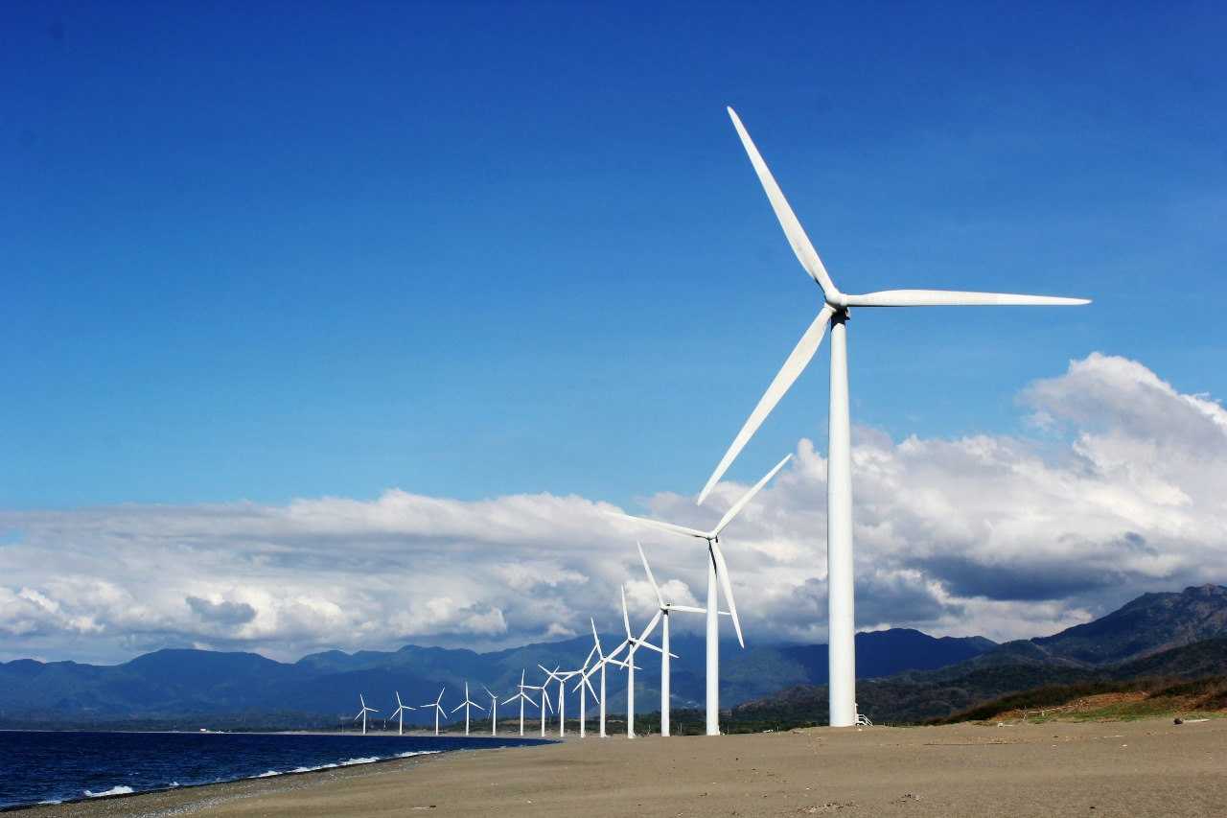


WIND TURBINE FAILURE
WIND TURBINE FAILURE
Presented by
K. Pavan Kumar

Slide 2

Project Leadership
Sharat Manikonda
Director at Innodatatics and Sponsor
linkedin.com/in/sharat-chandra

Slide 3
Contents
Business Problem
Project Architecture
Data source and Extraction
Project overview and Scope
Data Dictionary
Exploratory Data Analysis
Data Pre-processing
Data Visualization
Notes:
Change

Slide 4

Business Problem
Business Problem : Unplanned failure of wind turbine engine is leading to huge losses and generation of electricity is negatively impacted.

Slide 5
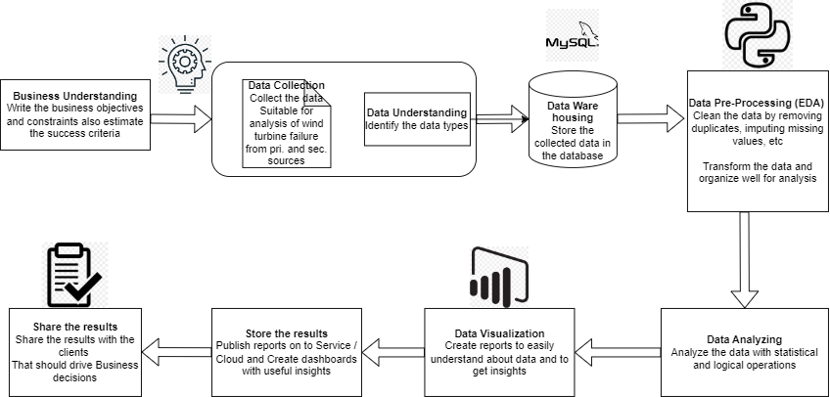
Project Architecture

Slide 6

Data Source and Extraction
Data Source and extraction – Data was searched from Kaggle, Git hub and other trusted Primary Sources and data also extracted from Clients database.

Slide 7




Project Overview and Scope
BUSINESS PROBLEM
Unplanned failure of wind turbine engine is leading to huge losses and generation of electricity is negatively impacted.
OBJECTIVES
Minimize Unplanned failure.
CONSTRAINTS
Maximize Power generation.
WIND TURBINE FAILURE
Project fund : $20,000
Duration : 25 – 30 days
BUSINESS SUCCESS CRITERIA
Reduce the unplanned failure of wind turbine engine by at least 30%.
ECONOMIC SUCCESS CRITERIA
Achieve a cost saving of $2M per year due to reduction of unplanned downtime
ASSUMPTIONS
Failure patterns remain relatively stable over the analysis period.
RISKS
Inaccurate or incomplete data leading to flawed predictions

Slide 8

Data Dictionary
Features | Range | Description
Wind speed (m/s) | 2 m/s (144 km/h, 89 MPH) to 72 m/s (259 km/h, 161 MPH) | The survival speed of commercial wind turbines. Wind speed describes how fast the air is moving past a certain point.
Power (kW) | 2 MW and 3.5 MW. | Power output of wind turbine. Wind power describes the process by which the wind is used to generate mechanical power or electricity.
Nacelle ambient temperature (Â°C) | -20°C to 40°C | level of temperatureon ground. they must withstand a wide range of ambient temperature
Generator bearing temperature | 70 °C to 100°C | temperature of the bearing in generator. Bearing temperature shall not exceed 65°C under 30°C cooling water.
Gear oil temperature | 50 c to 90 c | gearbox oil temperature. Oils operating at high temperature require good viscosity and high resistance to oxidation and foaming.
Ambient temperature | 10°C to 57°C | level of temperatureon ground. Ambient temperature is the air temperature of any object or environment where equipment is stored.
Rotor Speed | 50-300 RPM | Rotational speed of a wind turbine rotor about its axis. Part of the turbine's drivetrain, the low-speed shaft is connected to the rotor and spins between 8–20 rotations per minute.
Nacelle temperature | 30°C to 60°C | temperature of the oil in generator. wind turbine nacelle is that they must withstand a wide range of ambient temperature.
Bearing Temperature | 70 °C to 100°C | The temperature of the bearing in degrees Celsius. Bearings in steam turbines will normally operate at temperatures below 180 degrees Fahrenheit.
Generator Speed | 1000 to 1800 rpm | The rotational speed required by most generators to produce electricity. a speed that allows the turbine's generator to produce AC electricity.
yaw angle | 0 to 60 Degree | The position of the yaw angle degrees. used to turn the wind turbine rotor against the wind.
Wind direction | 0 to 90 Degree | The direction of the wind in degrees.
Wheel hub Temperature | -40 °C to 80°C | The wheel hubs house the bearings that support the main shaft and blades of the wind turbine
Gear box inlet temperature | 40°C to 60°C | The gearbox inlet temperature is the temperature of the air or fluid entering the gearbox.

Slide 9
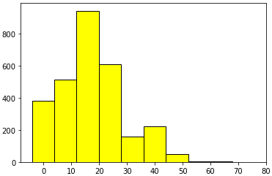
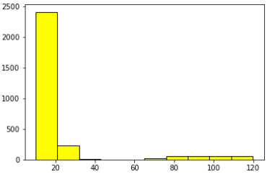
Exploratory Data Analysis [EDA]
KEY OBSERVATIONS
Power and Gear box inlet temperature has more extreme values on higher end with Skewness 2.438 and 2.979,Kurtosis 6.88 and 7.57 respectively i.e., highly positive skewed and tall peak.
Wheel hub temperature is normally distributed, all other features are slightly positive skewed or negative skewed.
Every variable is dependent on input variable wind speed.
Gear oil temperature, yaw angle, wind direction and gear box inlet temperature has zero correlation with wind speed
All other features has moderate negative correlation with wind speed
Notes:
EDA is used for seeing what the data can tell us before the modeling task.
Change

Slide 10

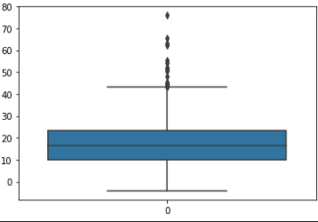
Data Preprocessing
KEY OBSERVATIONS
We may get wrong results by having missing values in dataset.7 features has missing values. Wind speed (20), Power (25), Nacelle ambient temperature(6), nacelle temperature (6), Generator speed (18), Yaw angle (26), Gear box inlet temperature (3) of total records.
Except Wheel hub temperature all features has outliers which also influence business decisions
Mean is influenced by having extreme values. So, Missing values are imputed by median imputation.
Missing data
Outliers
Notes:
Keep observations

Slide 11
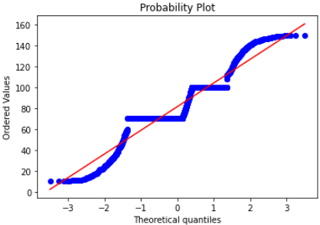
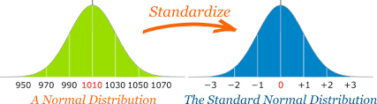
KEY OBSERVATIONS :
All the features are unsymmetrical.
Based on the Curves suitable transformation are applied to transform data into symmetrical, linearization, Curve fitting
Data is Scaled by Standardization to covert normal distribution to standard normal distribution.

Slide 12
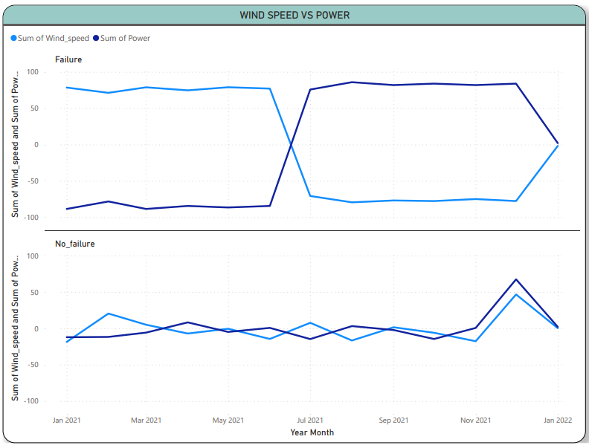
Data Visualization
KEY OBSERVATIONS :
Power output is dependent on wind speed.
Failure state : In failure state wind speed and power are opposite in nature
No failure state : In no failure state wind speed and power are constant within the limits
Notes:
Add graphical

Slide 13
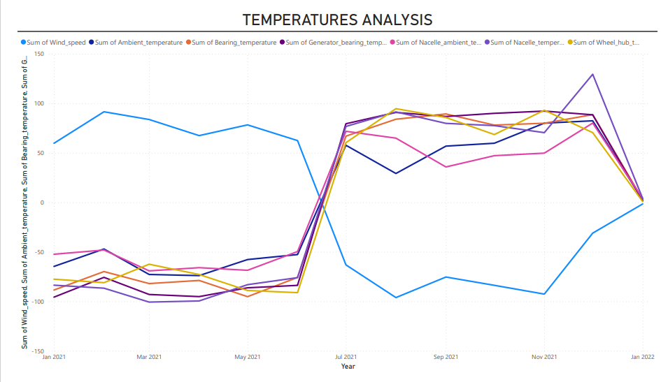
Generator speed and rotor speed increases with wind speed which increases temperatures of all components vice versa and give raise to losses and generation of power is negatively impacted.

Slide 14


